Slide 1

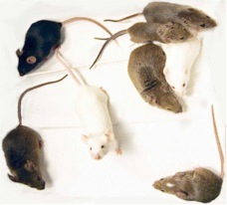
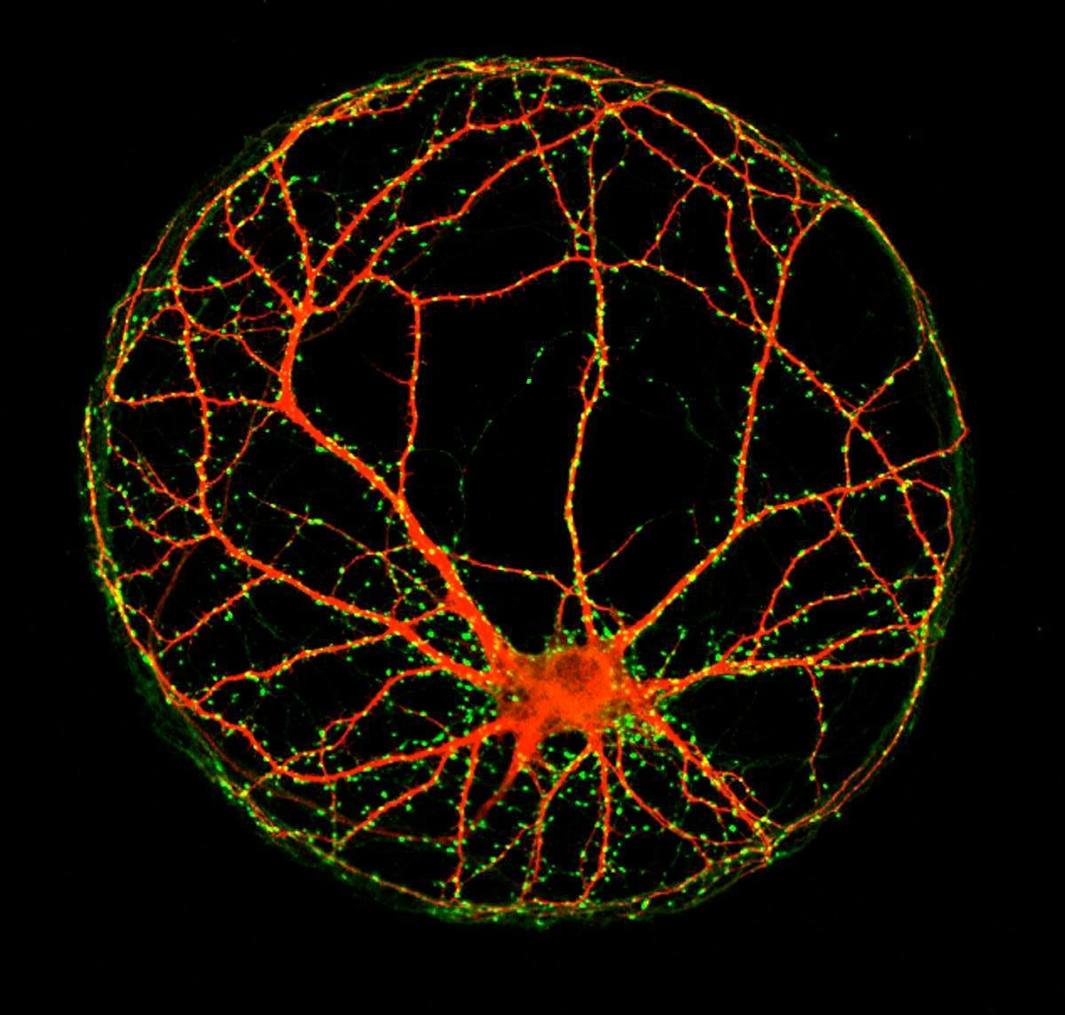
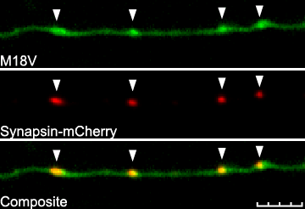
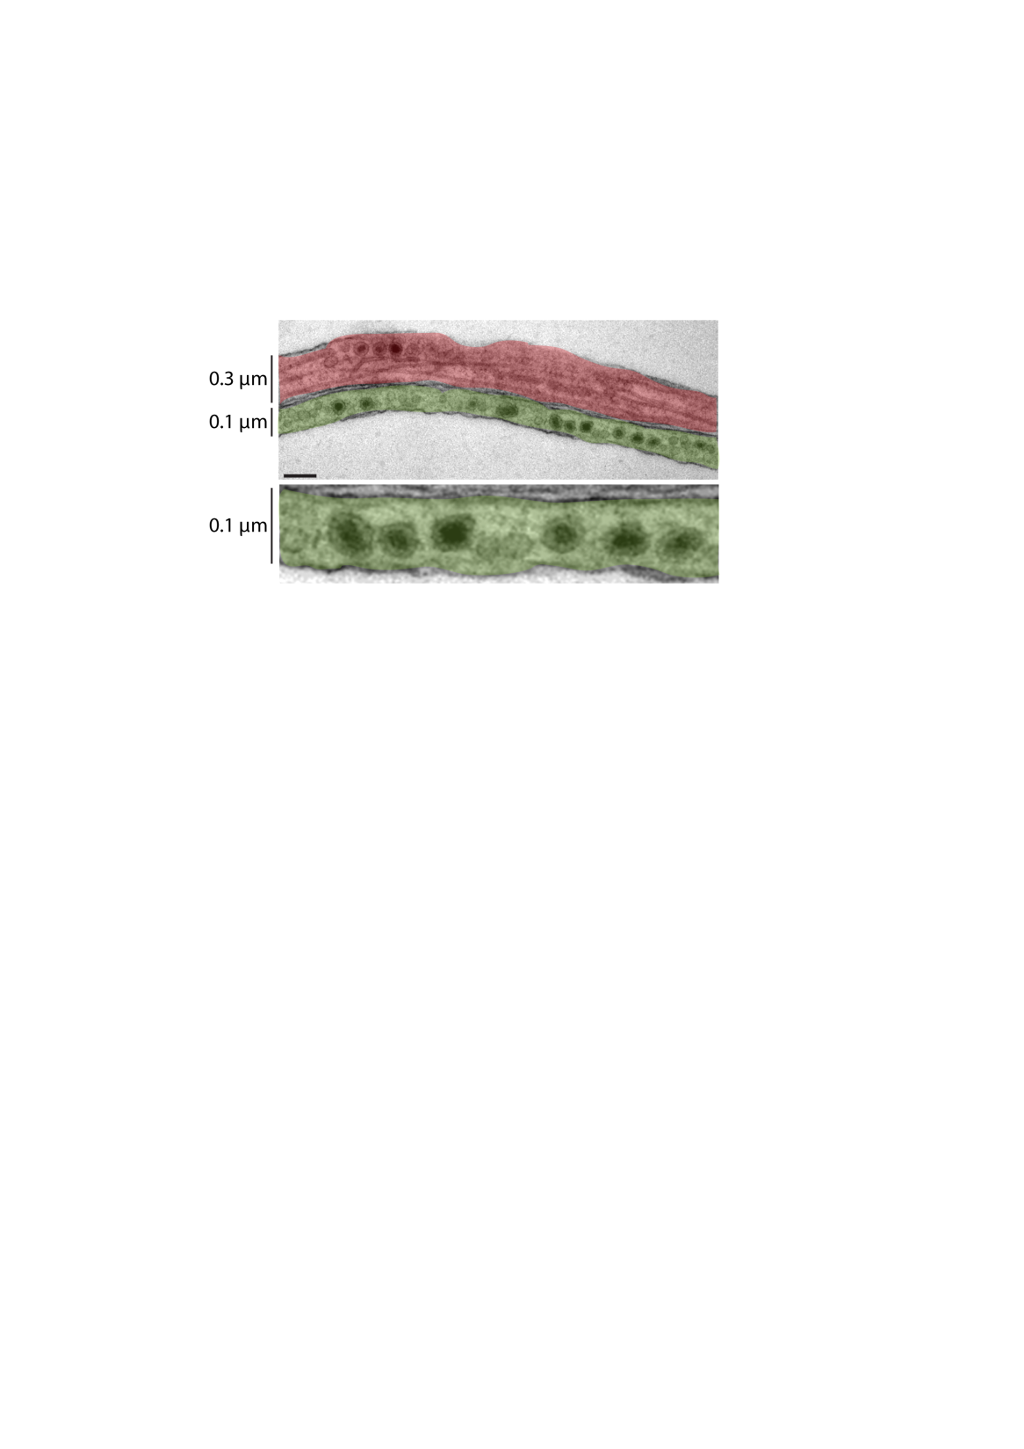

Development of a high-throughput optical assay for functional connectivity in neuronal culture
Tea Tompoš
Center for Neurogenomics and Cognitive Research – CNCR
Vrije Universiteit & VU Medical Center, Amsterdam, The Netherlands

Slide 2
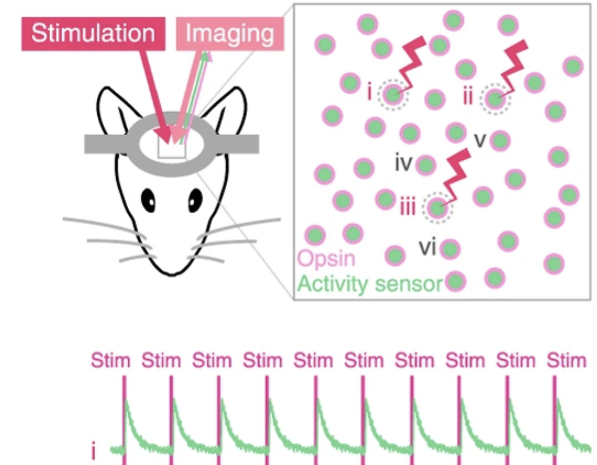
Definition of all-optical neurophysiology (AON)
the use of only optical tools to stimulate and record neural activity
Optical stimulation → light-sensitive proteins (opsins)
Optical recording → reporters sensitive to various activity-related hallmarks
Packer et al. (2015), Nature Methods

Slide 3
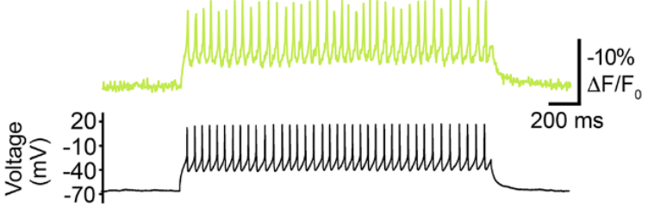
How does optical recording compare to electrophysiology?
Spatial resolution: single cell recordings limited in # neurons;
MEAs lack intracellular information and cell identity
Temporal resolution: reporter kinetics is slower,
however – very fast reporters are available
Other: imaging is non-invasive, scalable and suitable for longer experiments
﻿Abdelfattah et al. (2019), Science

Slide 4
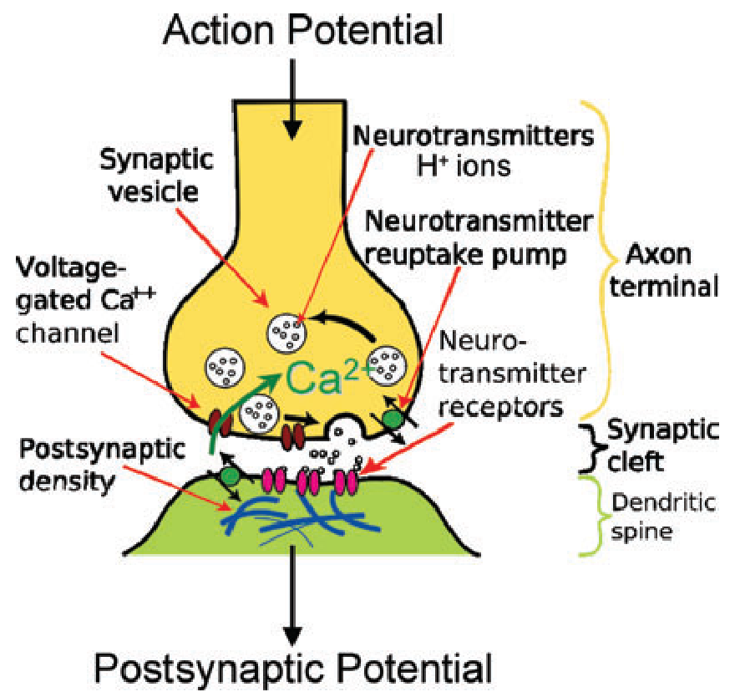
Optical reporters offer direct detection of presynaptic processes
Ephys approach:
Information comes from postsynaptic NT-mediated currents
Optical approach offers direct measurement of:
SV fusion → pHluorin-based reporters
Release of NT → genetically encoded NT reporters
Dreosti and Lagnado (2011), Experimental Physiology

Slide 5
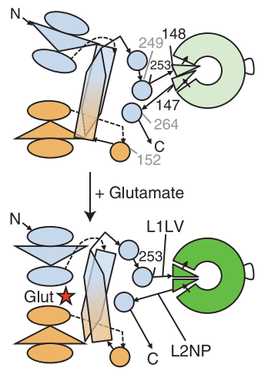
Introducing .. the iGluSnFR!
intensity-based glutamate-sensing fluorescent reporter
Ligand-free state → dim, resulting in baseline fluorescence F₀
Glutamate-bound state → increase in brightness, quantified as ﻿∆F/F₀
E. coli Glt1 cpGFP
Marvin et al. (2013), Nature Methods

Slide 6
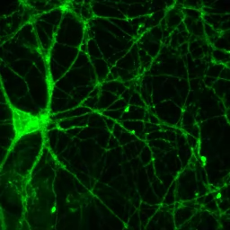
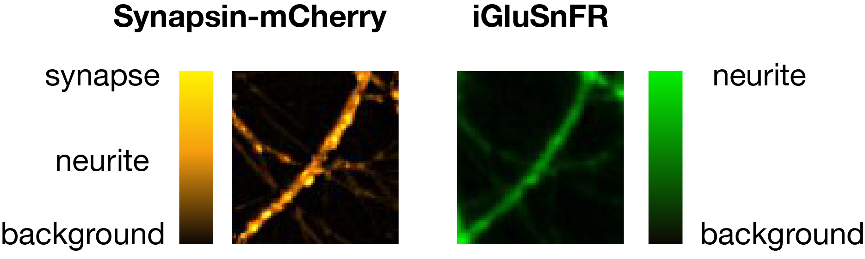
Autaptic cultures are used to focus on presynaptic transmission
Experimental model: autaptic culture of mouse hippocampal cells
Expressing two constructs:
Synapsin-mCherry → used to find synaptic puncta
iGluSnFR → used to monitor activity
iGluSnFR

Slide 7
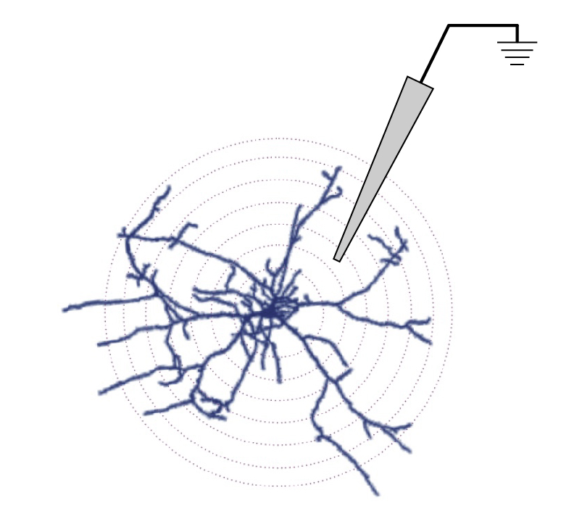
Does iGluSnFR ∆F/F₀ come from AP-mediated glutamate release?
Tetrodotoxin (TTX) blocks propagation of AP by blocking Na⁺ channels
H₀: synapses treated with TTX should not show an increase in iGluSnFR signal upon stimulation
Experimental design:
LPF electrode
baseline (1min)
10AP @ 2Hz
Naïve – imaged in 2mM [Ca²⁺]_{e} imaging solution (Tyrode)
1 µM TTX – acute application (1 min) to Tyrode
Notes:
Na+ is sodium

Slide 8
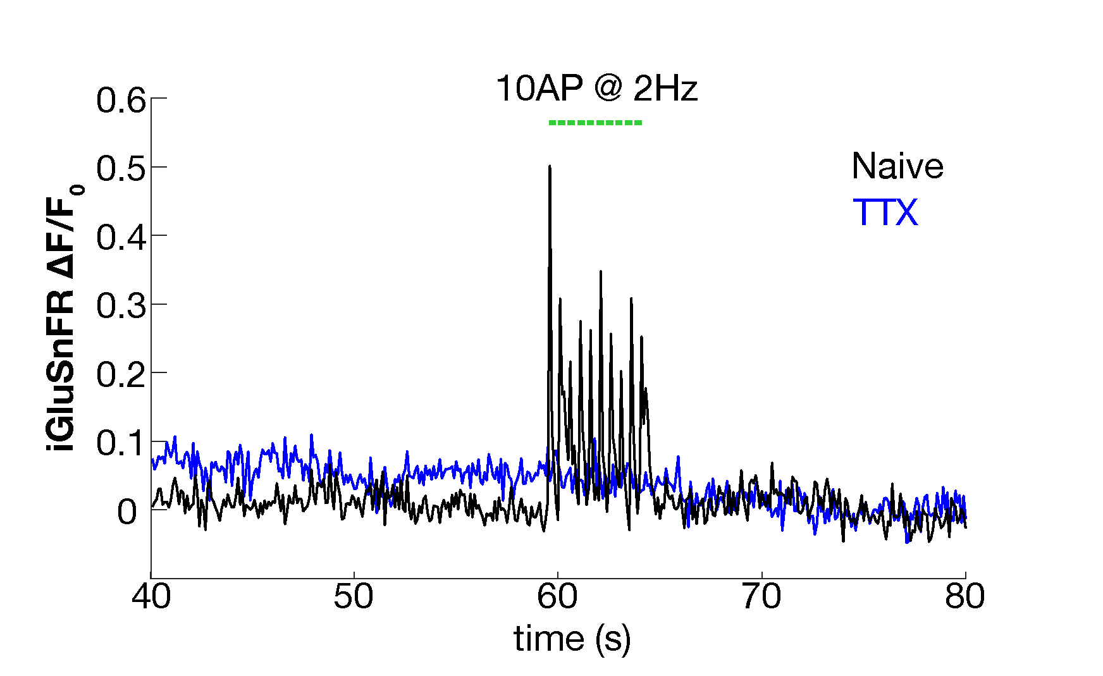
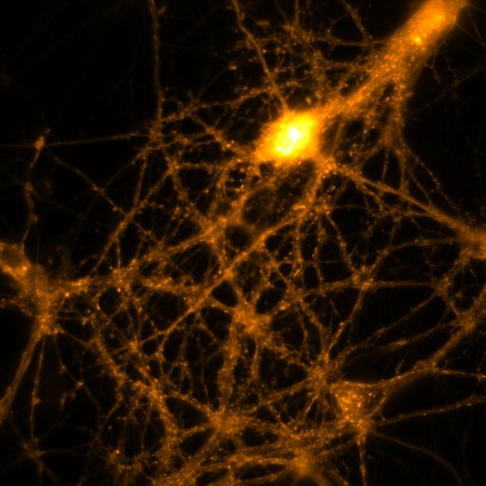


Action potential-mediated glutamate release underlies iGluSnFR ∆F/F₀
Individual synaptic response show no activity after acute TTX treatment
Synapsin-mCherry
naïve
TTX

Slide 9
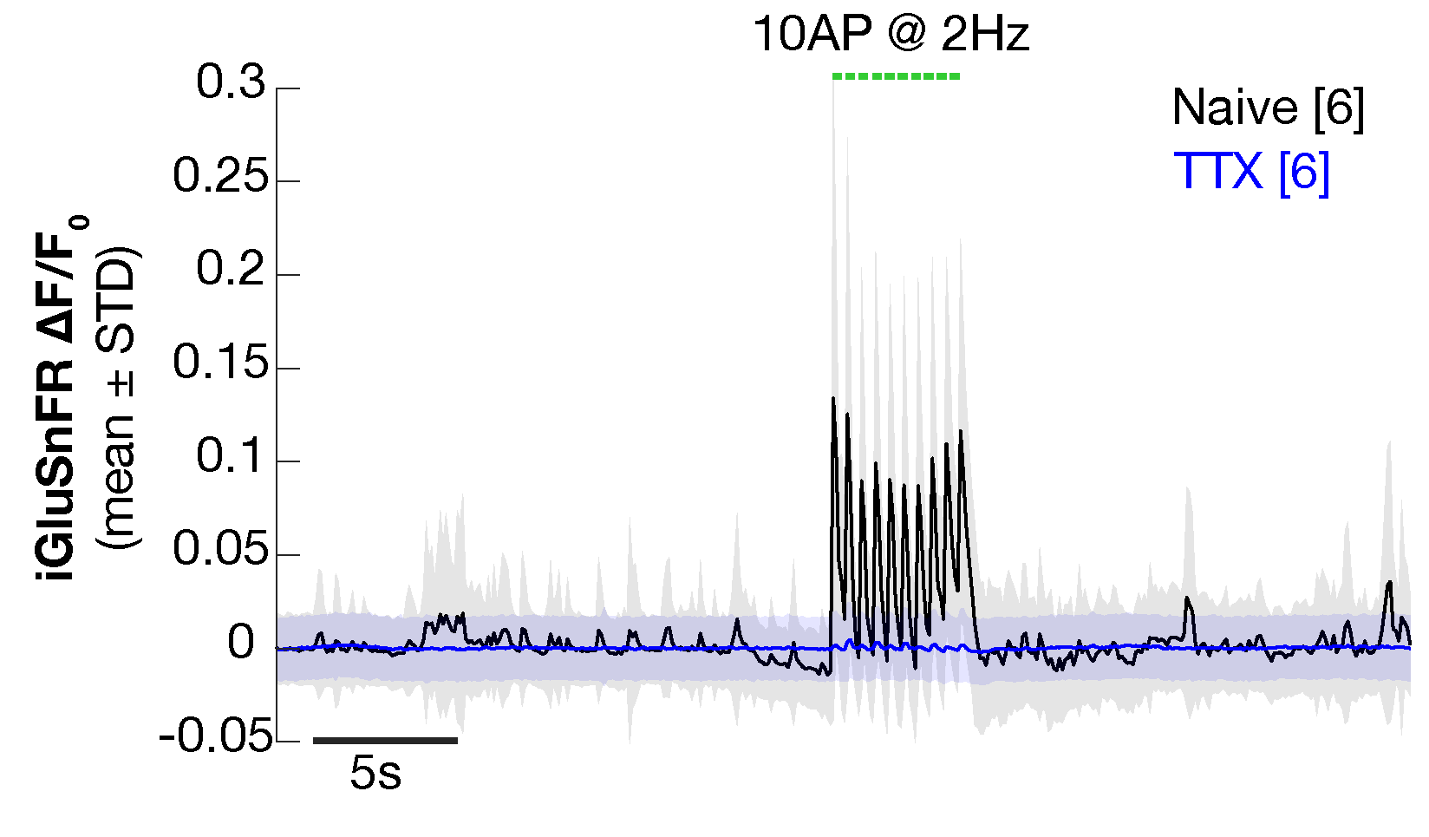
Action potential-mediated glutamate release underlies iGluSnFR ∆F/F₀
Average of all synaptic responses confirms no activity after acute TTX treatment
Synapsin-mCherry
naïve
TTX

Slide 10
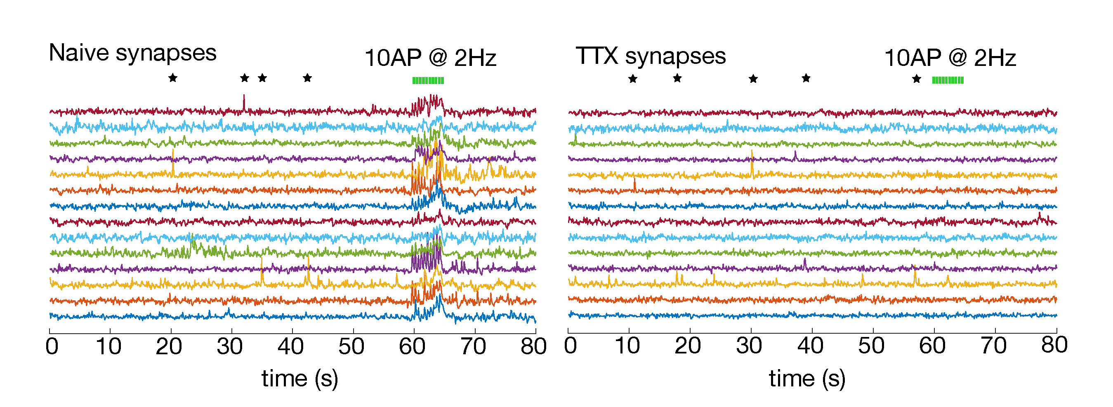
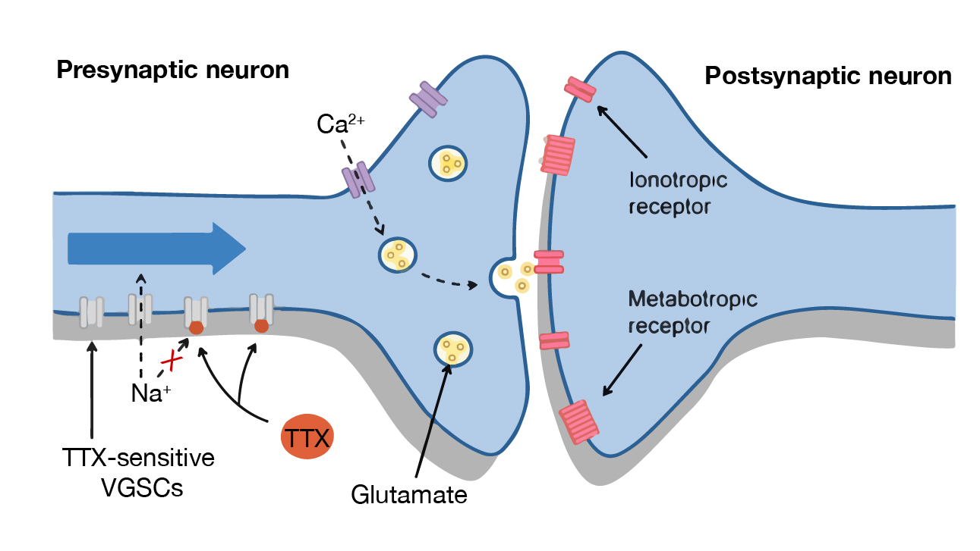
Sensitivity of the iGluSnFR reporter sufficient to detect mGT events
TTX incubation blocks AP propagation but does not affect spontaneous fusion
Miniature glutamate transients (mGTs) represent spontaneous synaptic vesicle (SV) fusion events

Slide 11
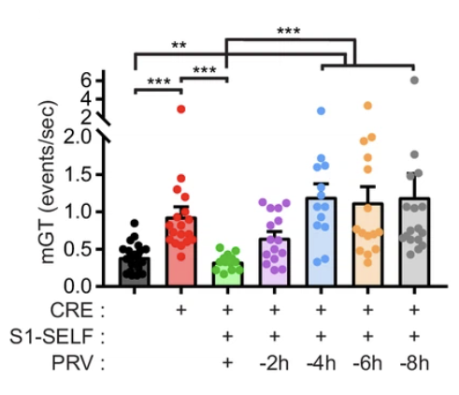
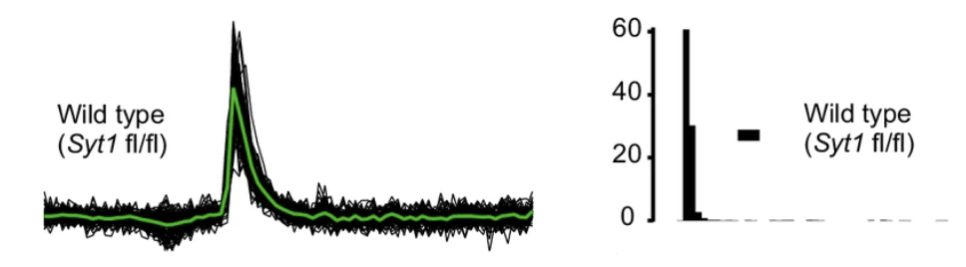
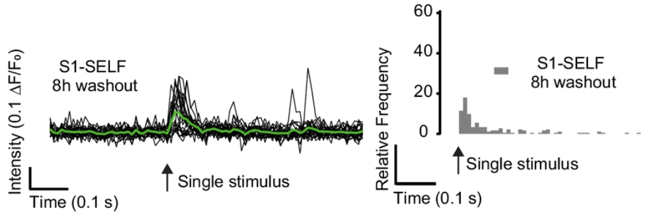
iGluSnFRs used to quantify spontaneous and synchronicity release
Vevea and Chapman (2020), eLife
Conditional synaptotagmin 1 (STY1) knockoff experiment
2. Loss of synchronous SV release
1. Increase in spontaneous release
Vevea and Chapman (2020), eLife

Slide 12
Intermediate conclusions
change in iGluSnFR’s fluorescence comes from presynaptically released glutamate
TTX blocks AP propagation but not mGT events
iGluSnFR’s sensitivity is sufficient to report spontaneous, single fusion events
iGluSnFR is a reliable reporter for quantitative research

Slide 13
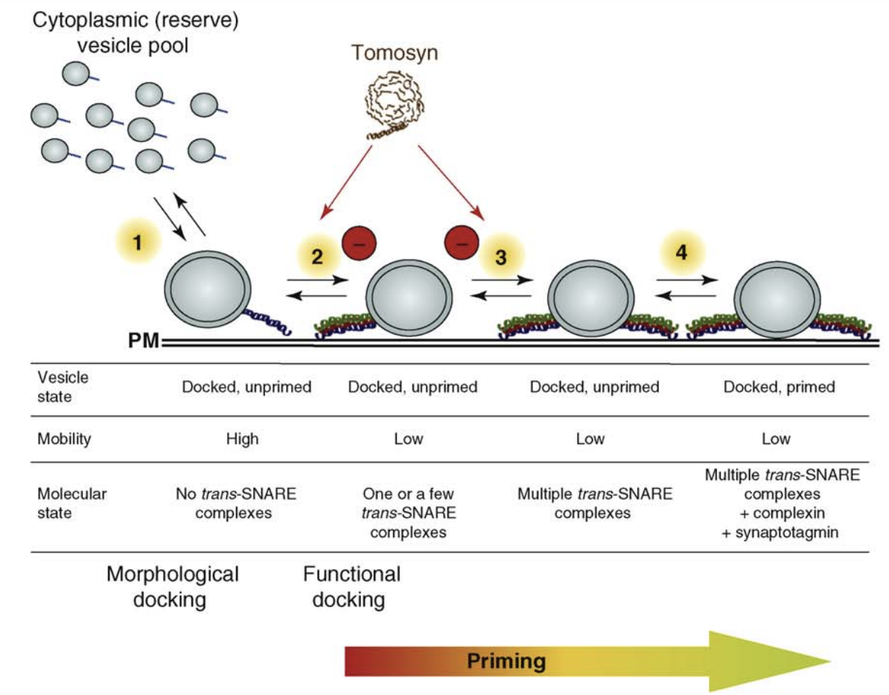
What is a good model for studying altered synaptic activity using iGluSnFRs?
A protein interacting with SV secretory machinery:
Tomosyn negatively regulates NT release by:
Attenuating immobilization of newly arriving SVs
Reducing release probability of docked vesicles
Ashery et al. (2009), Trends in Neurosciences

Slide 14
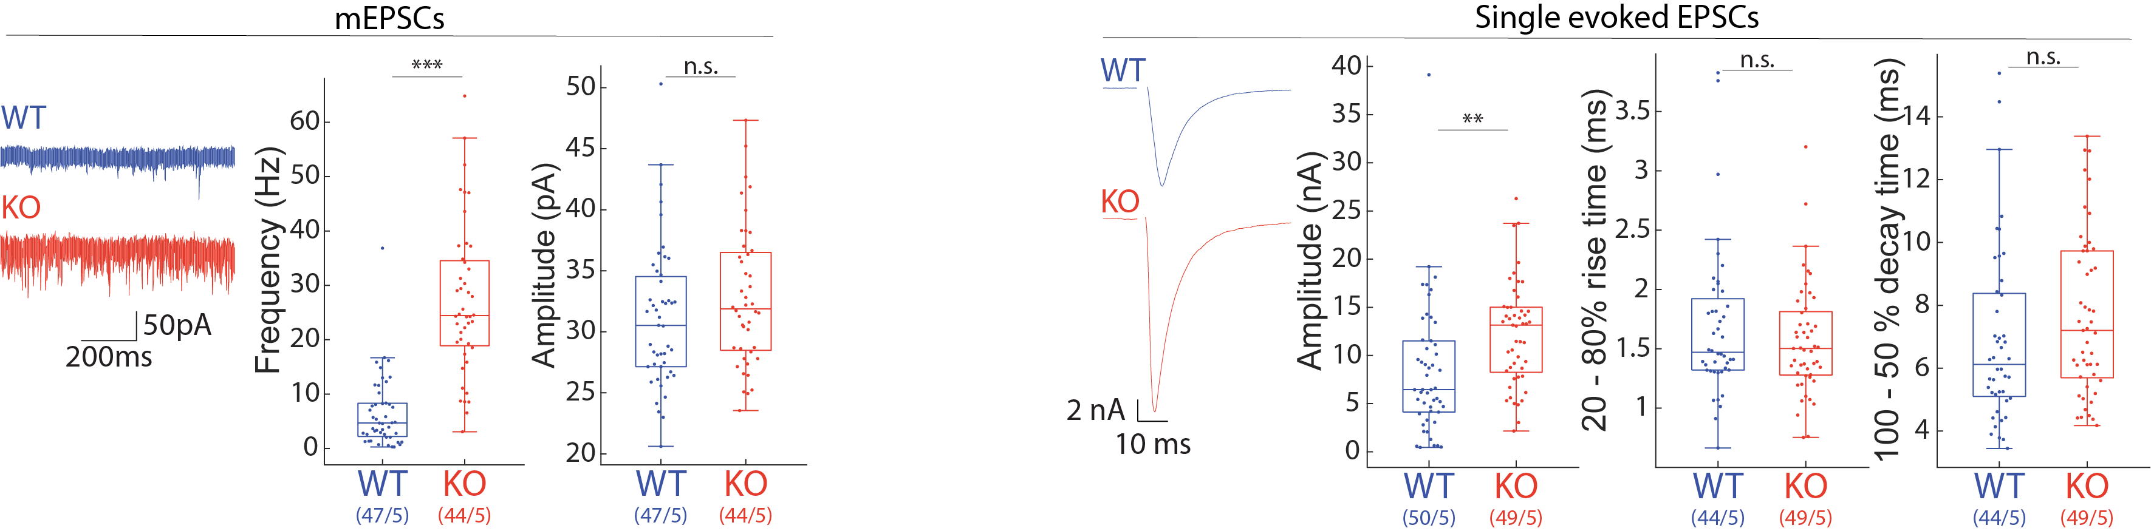
Known Tomosyn phenotype comes from ephys research
1. Increase in spontaneous release
2. Increase in 1st-evoked response
What can Tomosyn tell us about iGluSnFRs?
Are iGluSnFRs able to report known Tomosyn phenotype seen in ephys?
... and vice versa?
Can we detect any additional changes?
(kindly provided by M. Meijer and M. Öttl)

Slide 15
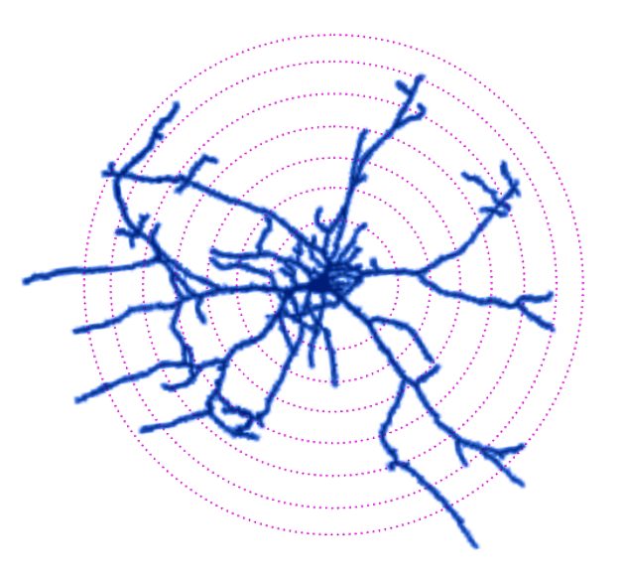
Can iGluSnFRs recapitulate known phyenotype seen in Tomosyn^{-/-} cells?
Wild-type mouse hippocampal neuron
CELL LINES:
STIMULATION TYPES: what response patterns are we able to detect?
Tomosyn ^{-/-} mouse hippocampal neuron
baseline (1min)
5AP @ 0.75Hz
5AP @ 2Hz
100AP @ 40Hz 1AP 1AP
Notes:
Cre-dependent knockout

Slide 16
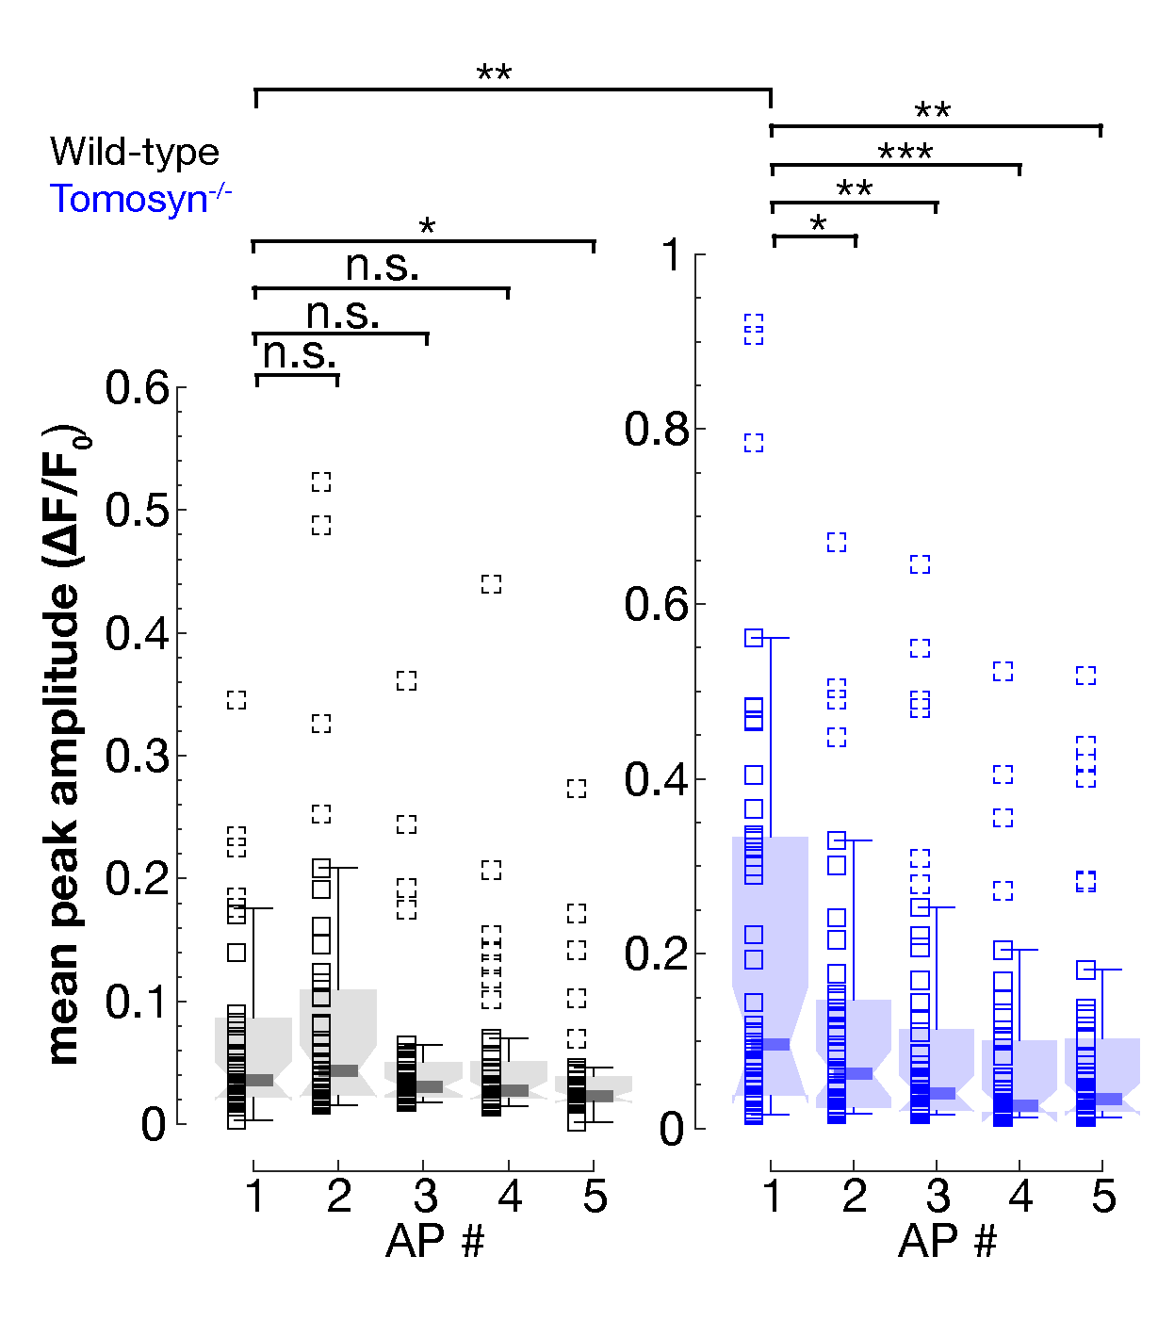
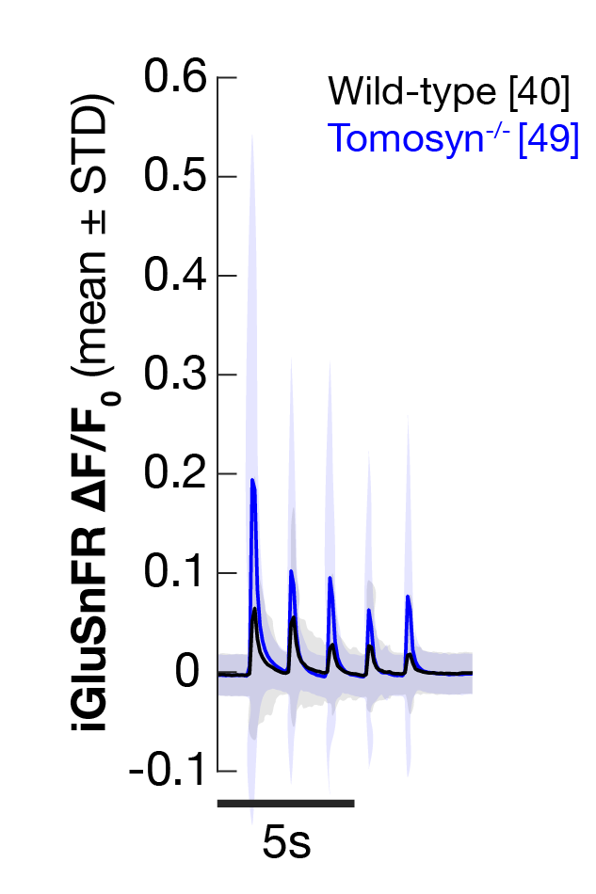
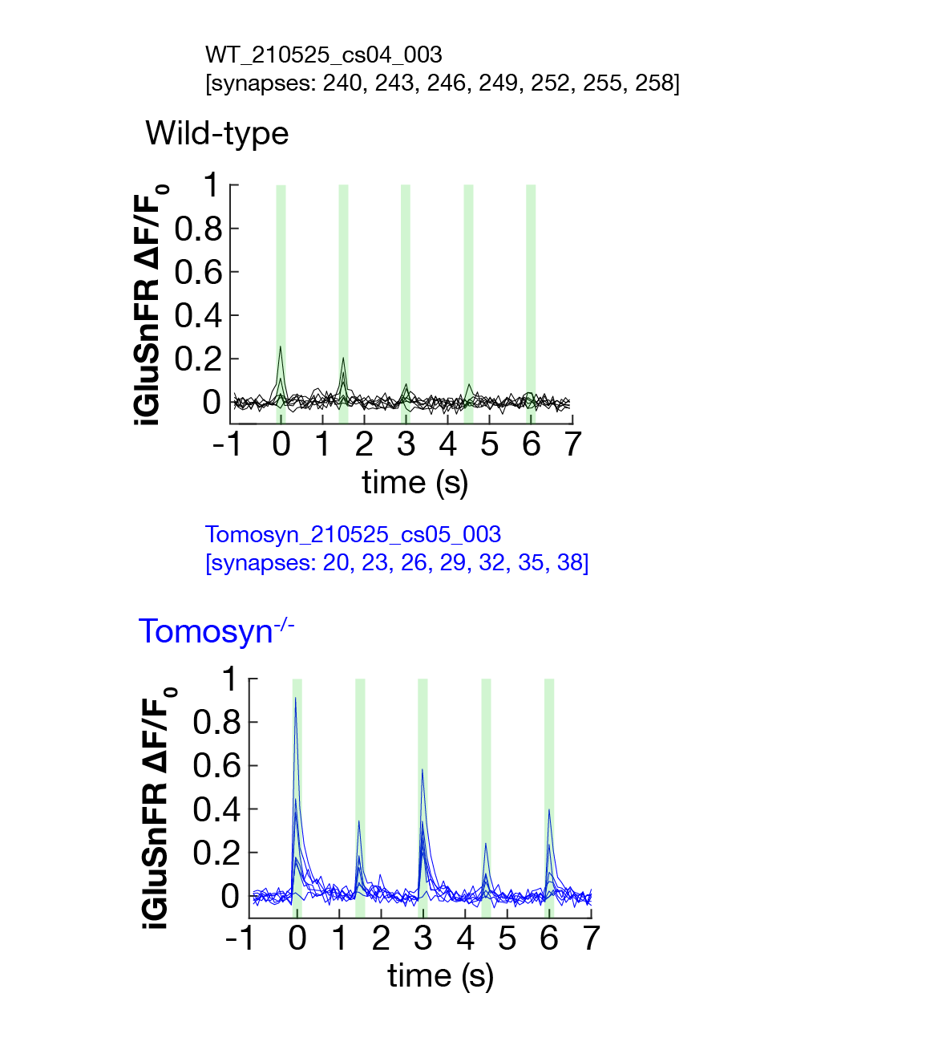
Stimulated activity shows differences in evoked synaptic responses
5AP @ 0.75Hz

Slide 17
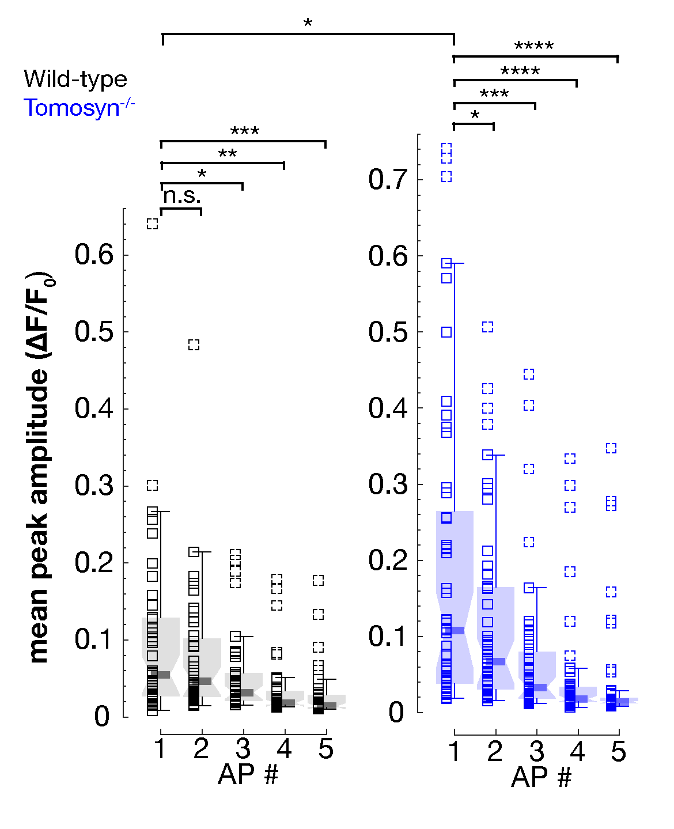
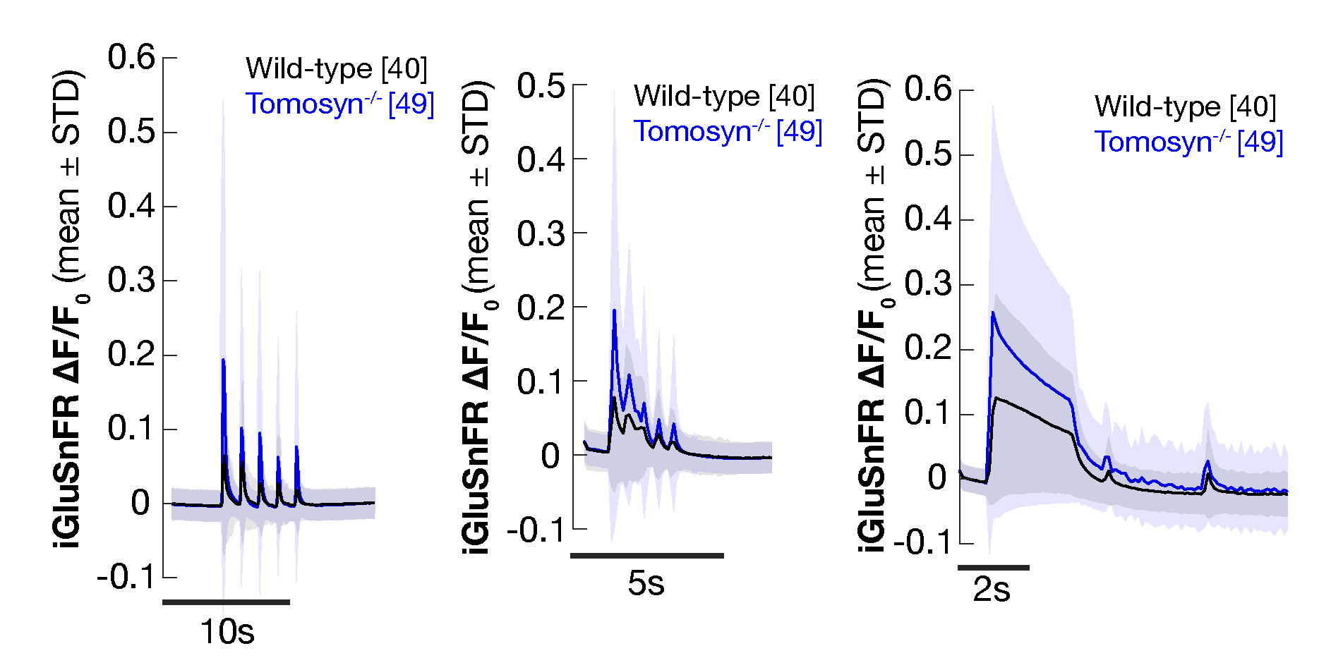
Stimulated activity shows differences in evoked synaptic responses
5AP @ 2Hz
100AP @ 40Hz 1AP 1AP
Tomosyn^{-/-} neurons have stronger evoked synaptic response

Slide 18
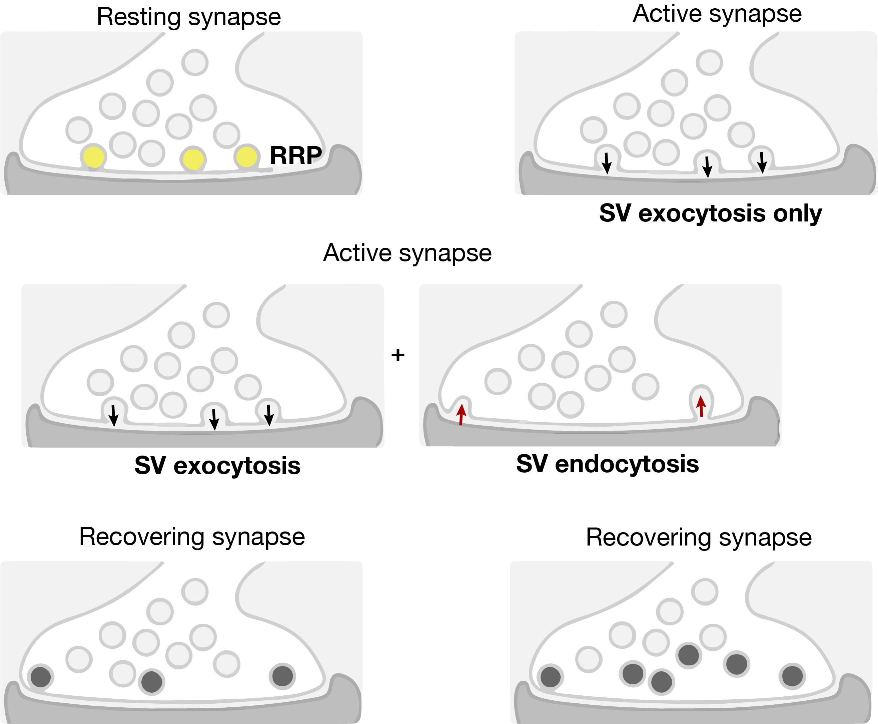
Synaptic vesicle pool dynamics
1
Vesicle pool depletion
4
1
2
2
Pool depletion and recovery
3
3
4

Slide 19
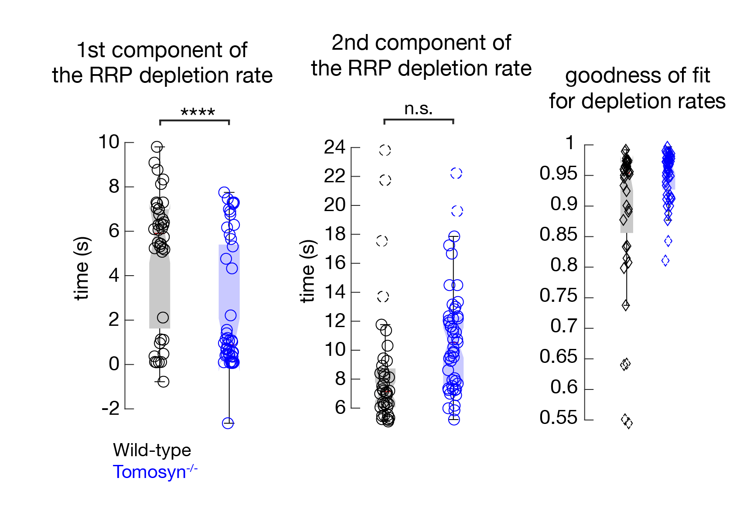
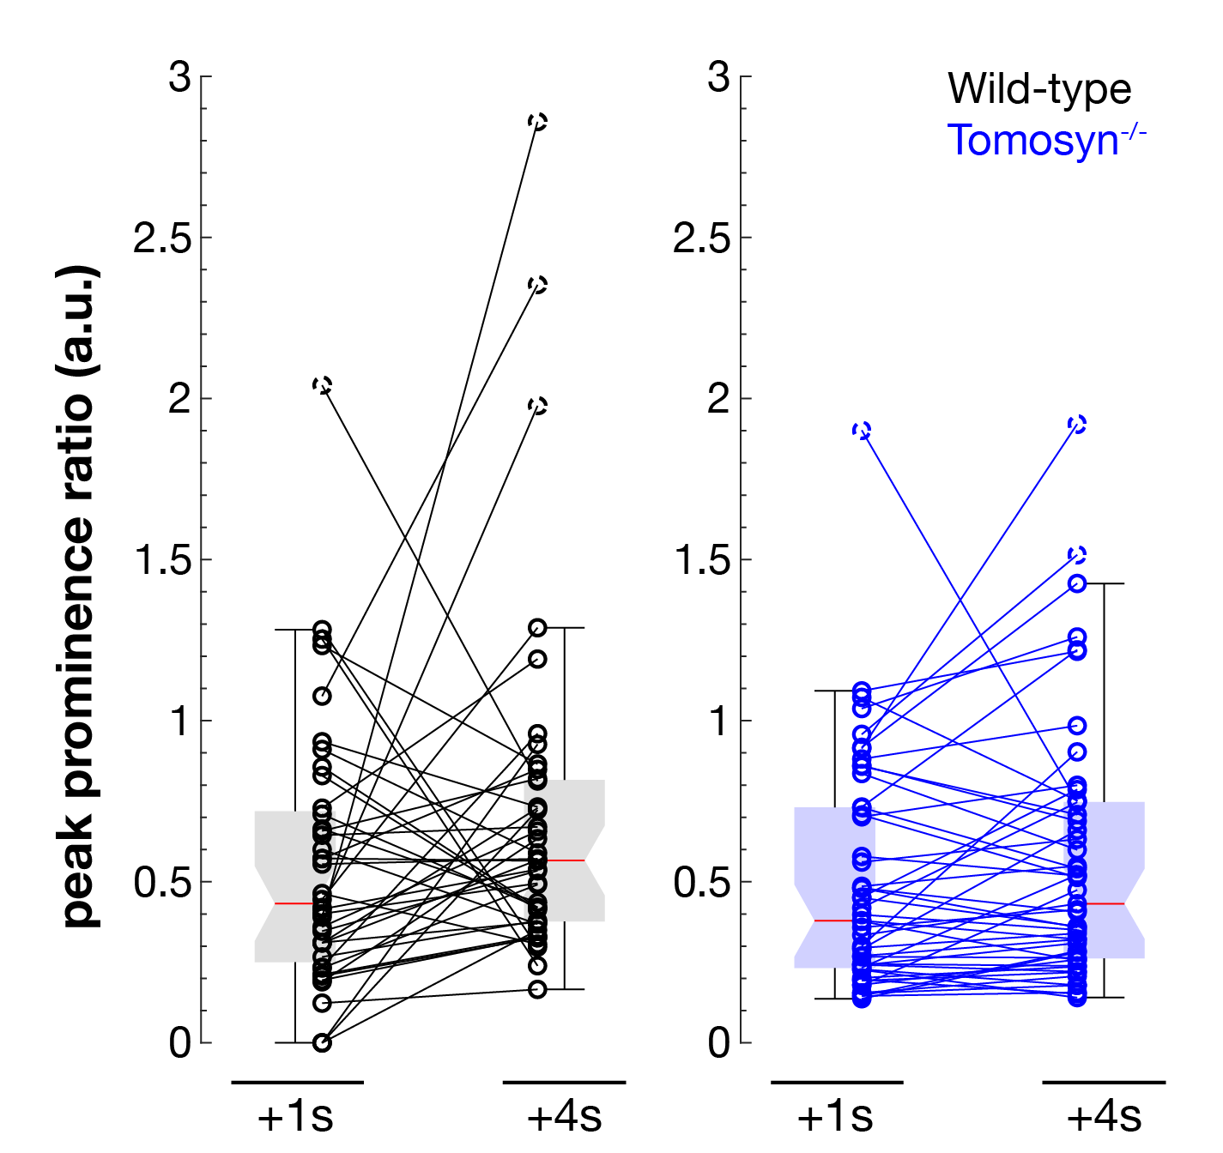
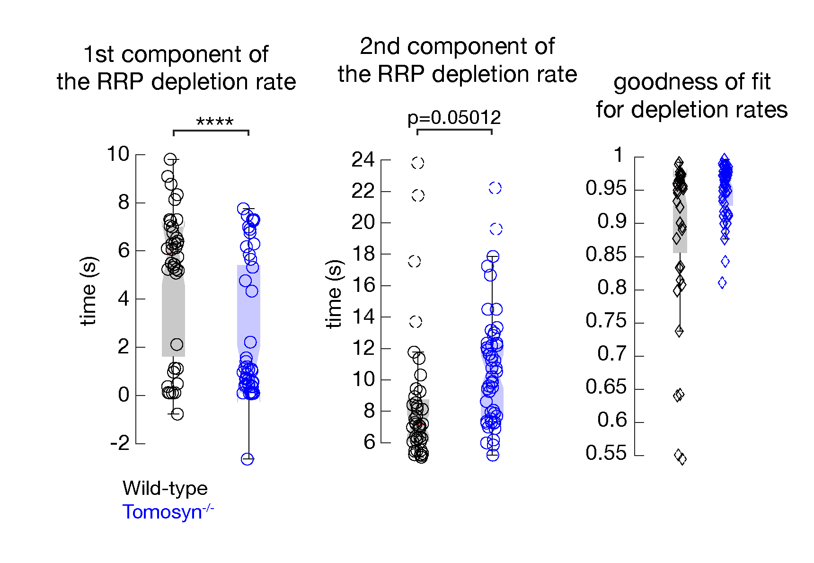
Vesicle pool dynamics is different between genotypes
Pool depletion
Pool depletion and recovery
Pool recovery
1
2
3
4

Slide 20
Intermediate conclusions
Synapses lacking Tomosyn show stronger evoked response when compared to Wild-type
Amplitude of the first evoked AP is significantly increased in Tomosyn^{-/-} synapses when compared to wild-type
Vesicle pool depletes faster in absence of Tomosyn

Slide 21
Plausible explanation to an increased response from Tomosyn^{-/-}
Increase may result from more synapses contributing to the overall response
H₀: if synaptic participation underlies increased response, not all synapses should be firing to 0.75 Hz and 2 Hz stimulations

Slide 22
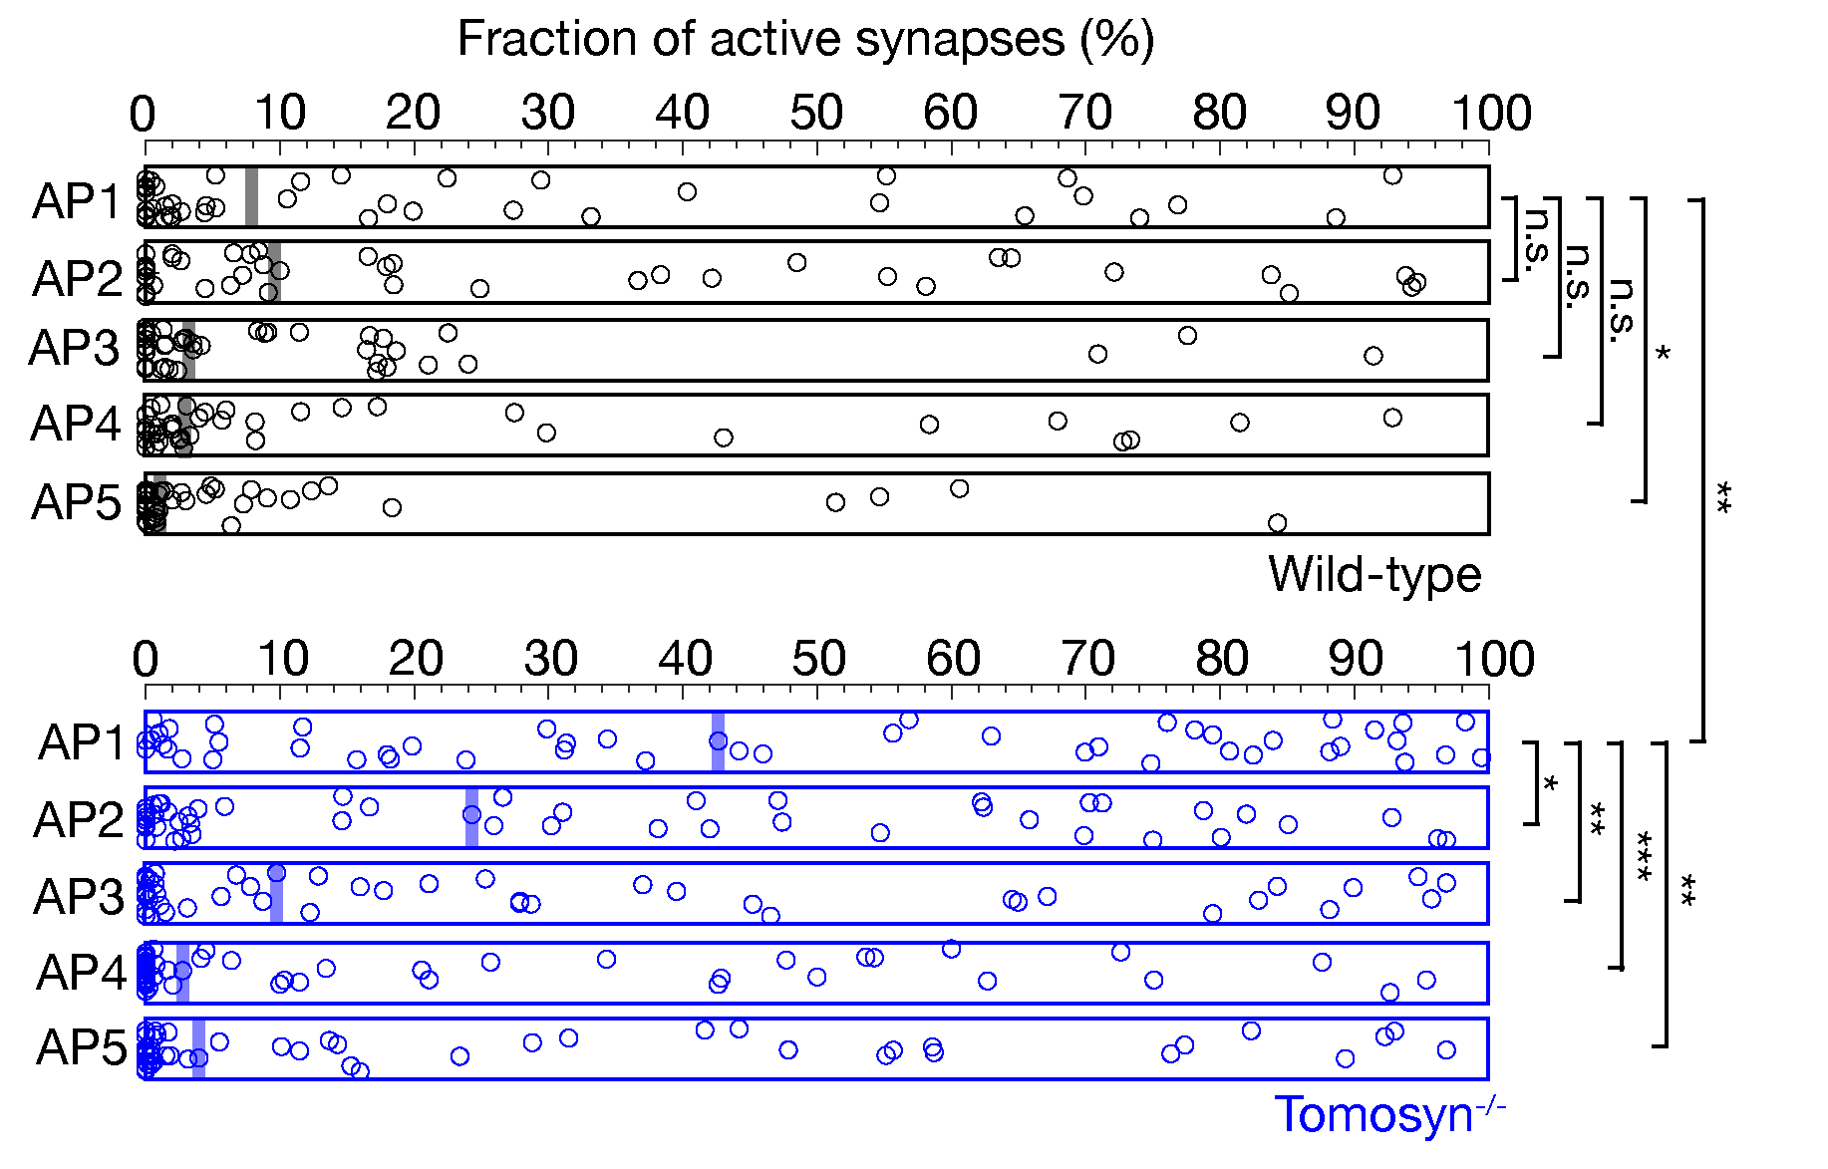
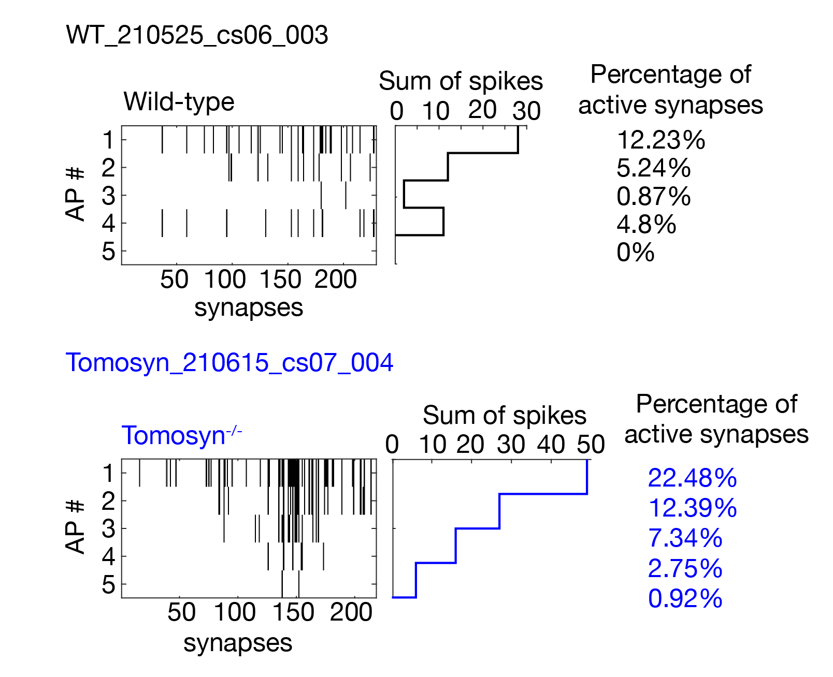
Synaptic participation differs between genotypes
5AP @ 0.75Hz
During 0.75 Hz stimulation, Tomosyn^{-/-} neurons have more active synapses per evoked AP

Slide 23
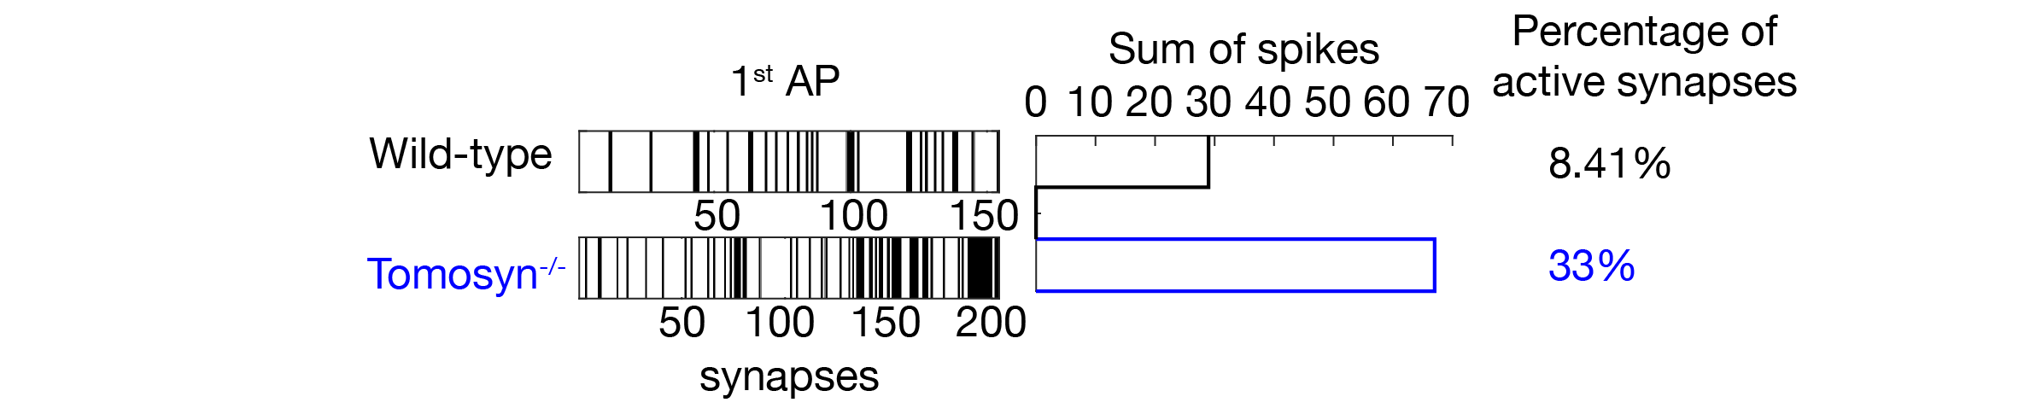
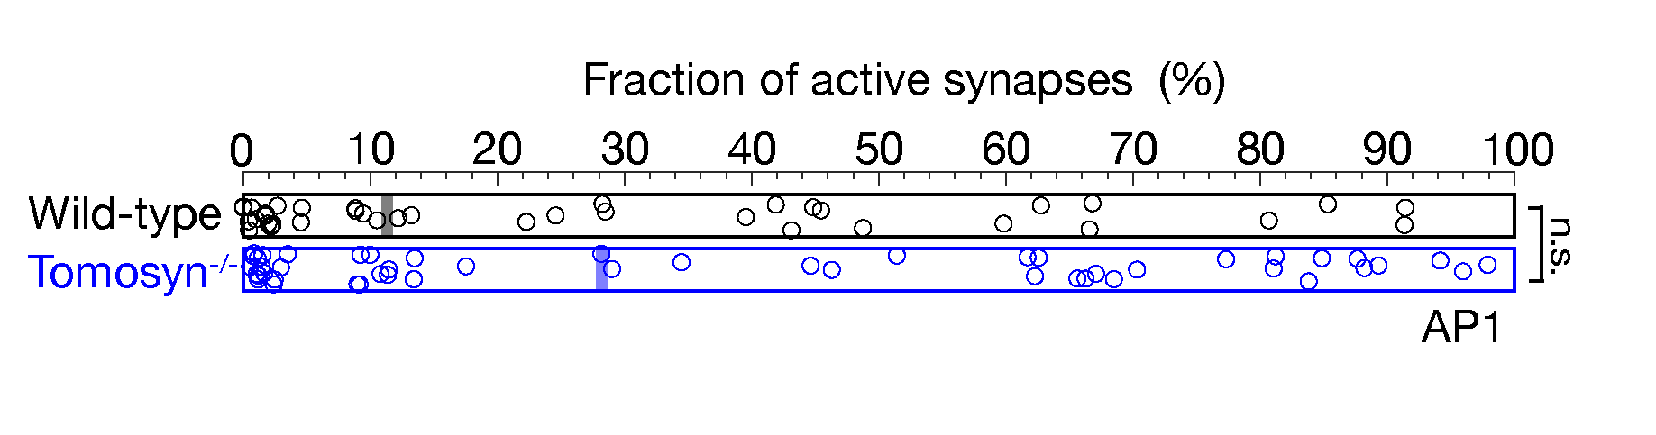
Synaptic participation differs between genotypes
5AP @ 2Hz

Slide 24
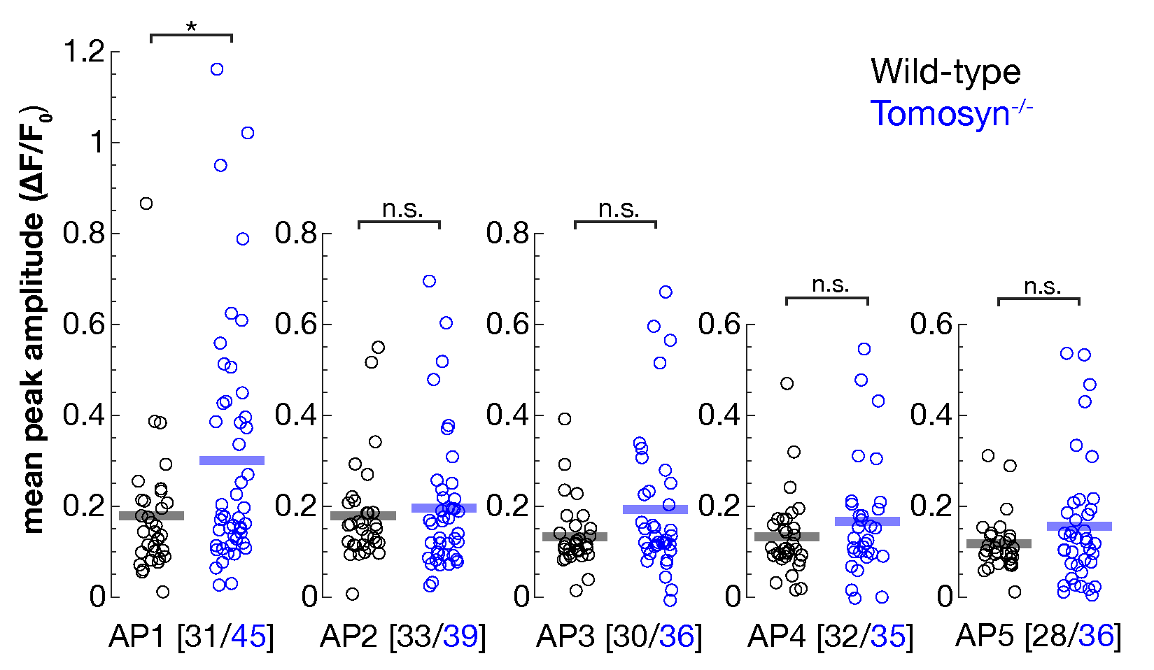
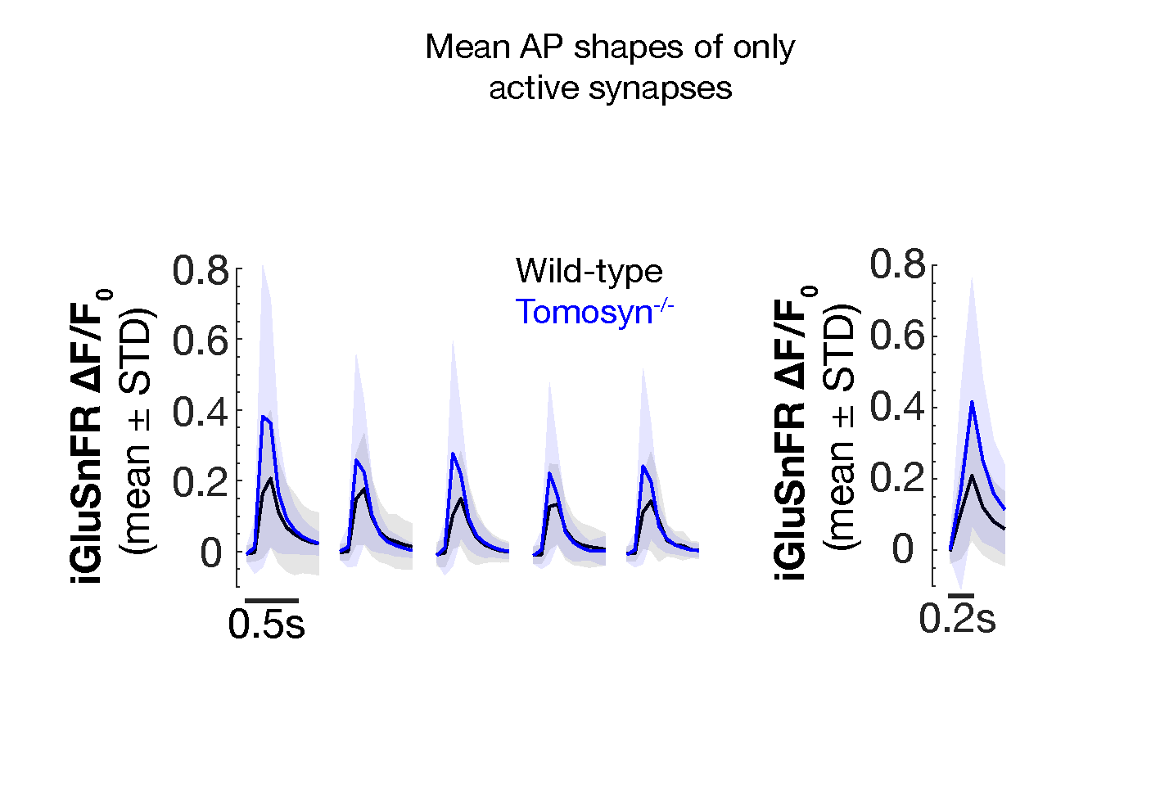
Is synaptic participation the only contributing factor to the increased 1st AP response?
H₀: If participation is the only mechanism driving stronger response in Tomosyn^{-/-} neurons, amplitudes of only the active synapses should be the same
Average AP shapes from active synapses:
5AP @ 0.75Hz
Significant difference seen in 1st-evoked only!

Slide 25
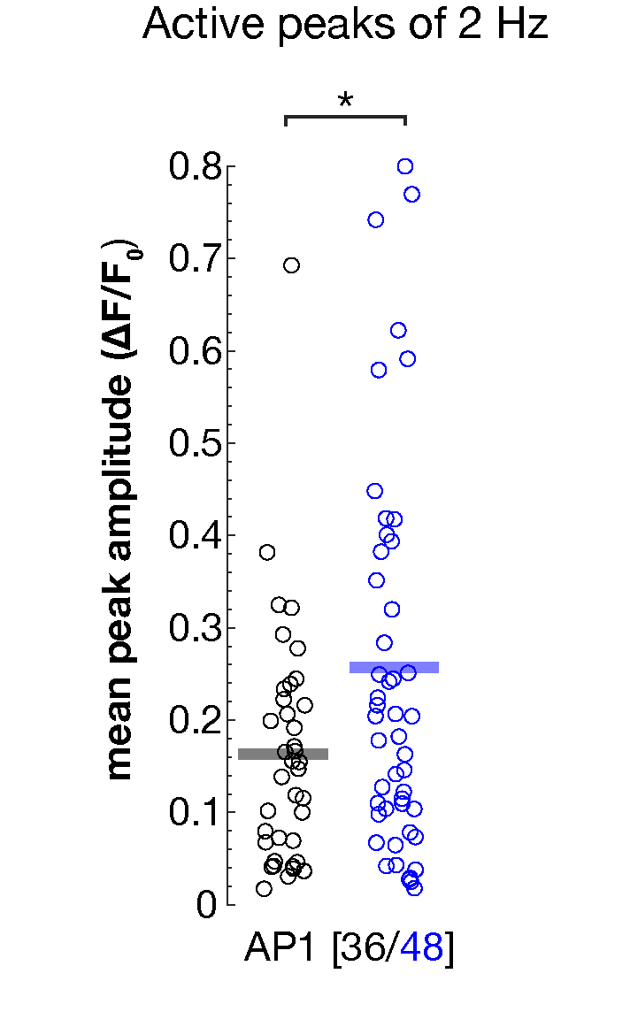
Average AP shapes from active synapses show differences in amplitude
Average AP shapes from active synapses:
Differences in AP amplitudes suggests that synaptic participation is not a single contributing factor to the increased 1st-evoked response
Other viable explanations:
More SVs fusing per synapse
More glutamate reseased per SV
5AP @ 2Hz

Slide 26
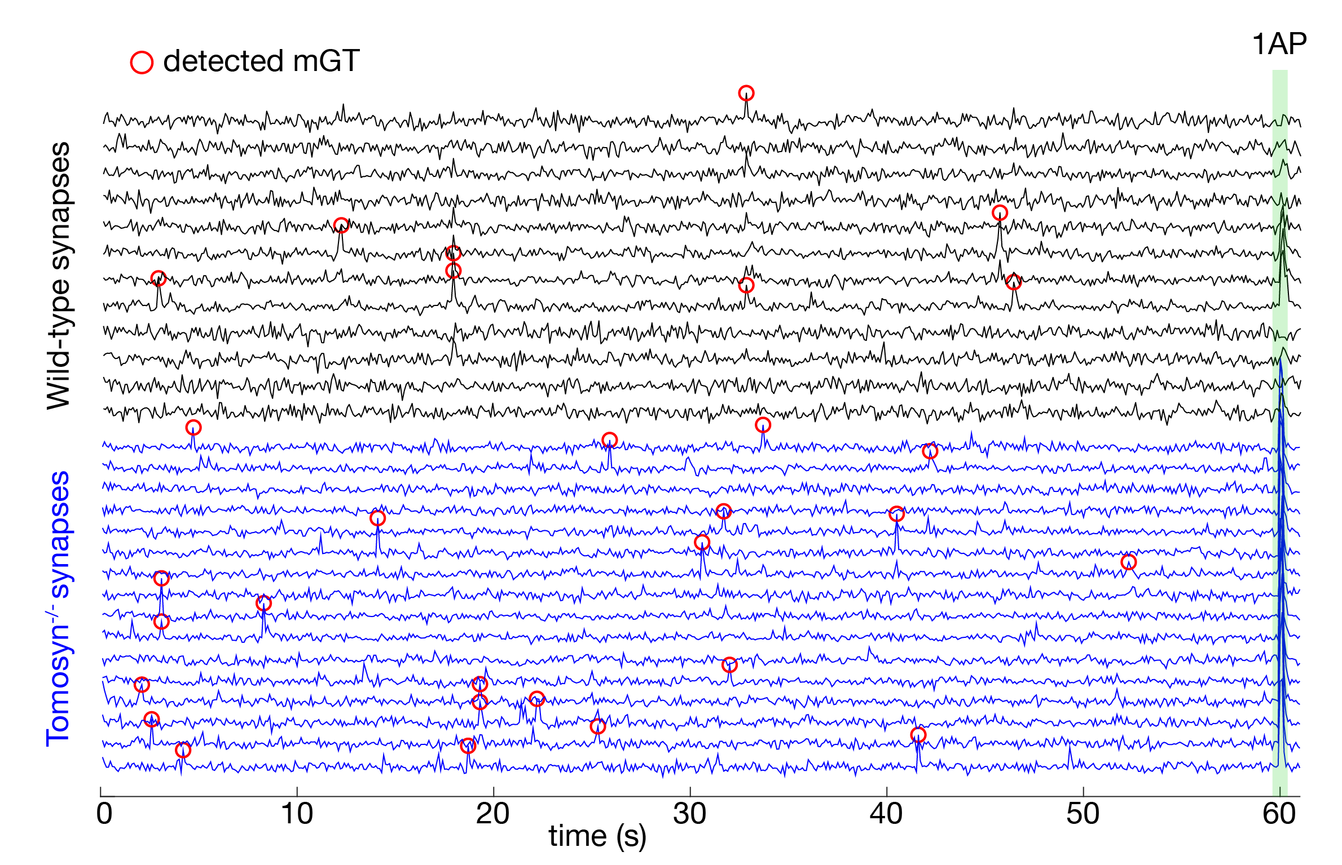
How to get the number of SVs that fuse per synapse using iGluSnFRs?
.. by looking into mGTs

Slide 27

How to get the number of SVs that fuse per synapse using iGluSnFRs?
.. by looking into mGTs
H₀: if one mGT event represents a fusion of one SV, then average mGT amplitude can be used to measure the number released SVs during evoked activity

Slide 28
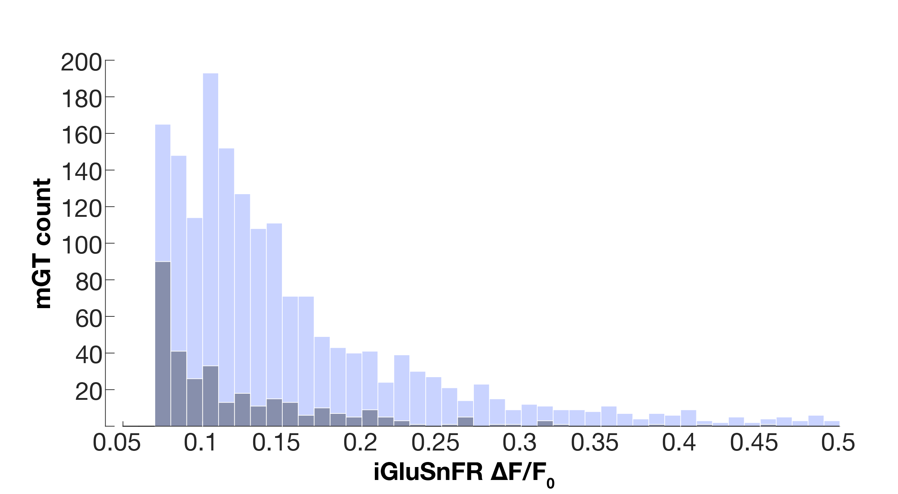
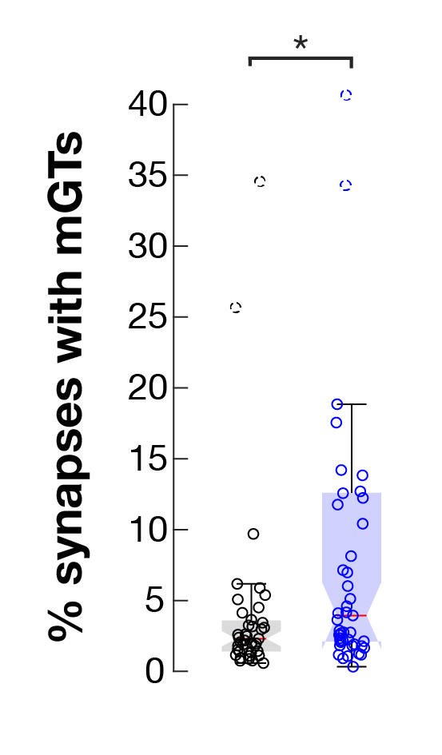
Distribution of detected mGT amplitudes
Number of mGT events is higher in Tomosyn^{-/-} neurons

Slide 29
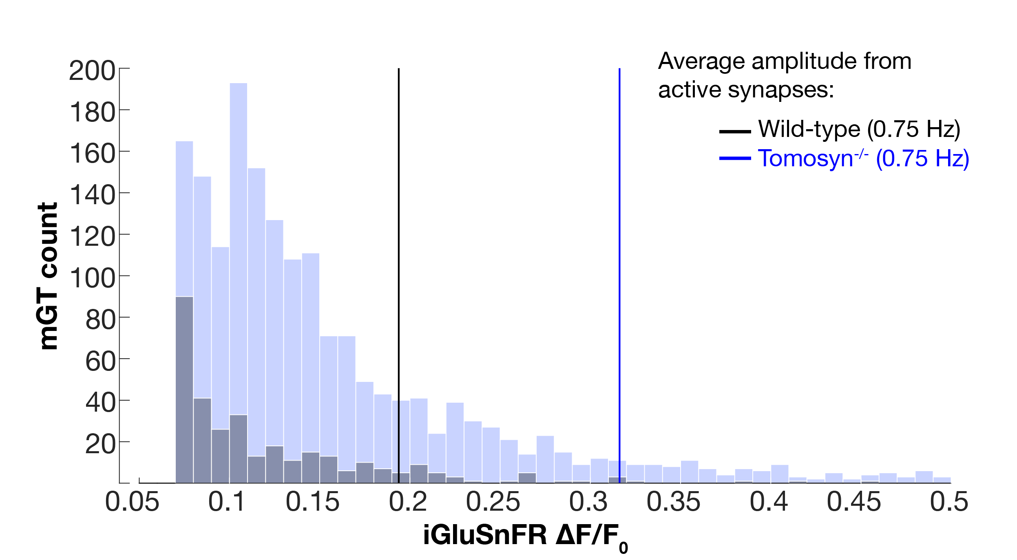
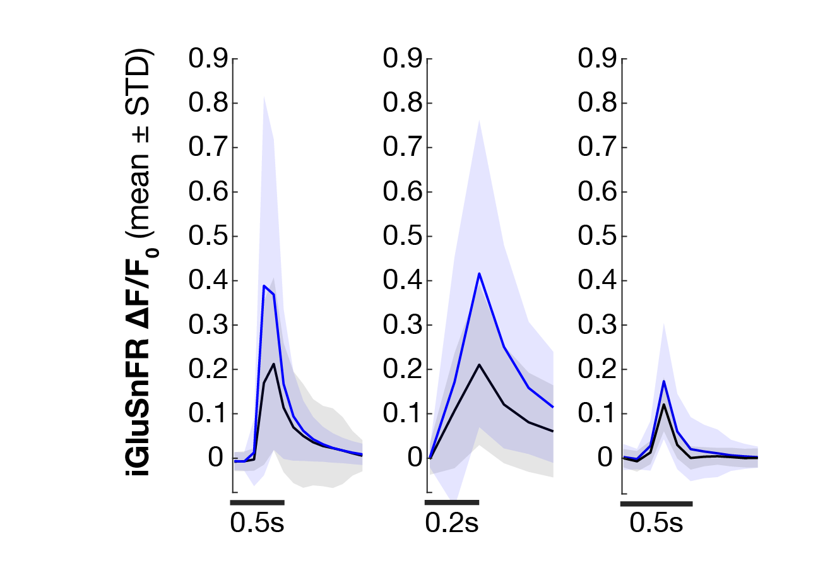
Distribution of mGT amplitudes compared to average 1st-evoked AP
Comparison of 1st-evoked and spontaneous shapes
0.75 Hz mGt

Slide 30
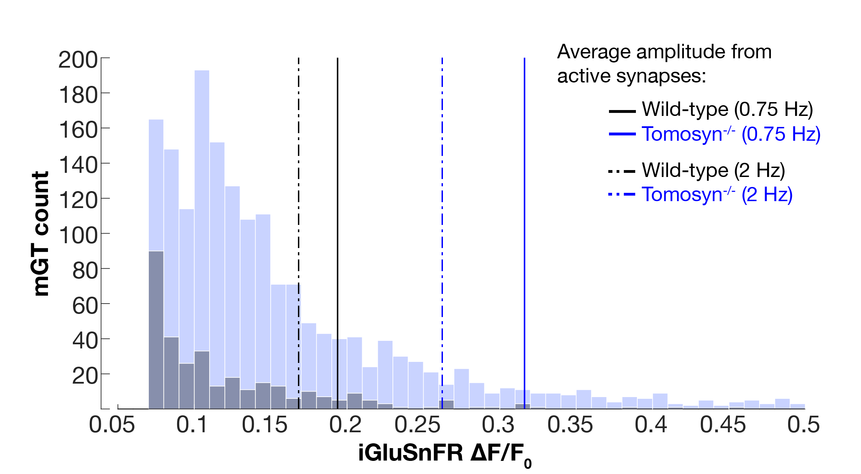
Distribution of mGT amplitudes compared to average 1st-evoked AP
Comparison of 1st-evoked and spontaneous shapes
0.75 Hz 2 Hz mGt

Slide 31
Final conclusions
Tomosyn^{-/-} synapses are more prone to spontaneous fusion (mGT)
Tomosyn^{-/-} neurons show stronger response during 1st-evoked activity due to:
higher levels of synaptic participation
possibly more than 1 SV fusing per evoked response

Slide 32





Acknowledgements
Mentor: Alessandro Moro
Supervisor: Ruud F.G. Toonen
Peer discussions and data:
Małgorzata Lubas
Aygul Subkhangulova
Marieke Meijer
Miriam Öttl
Toonen Group
FGA Lab
Receiving institution
Mother institution

Slide 33
Supplement

Slide 34
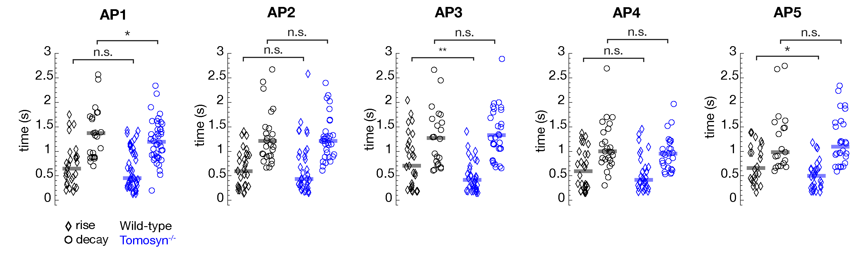
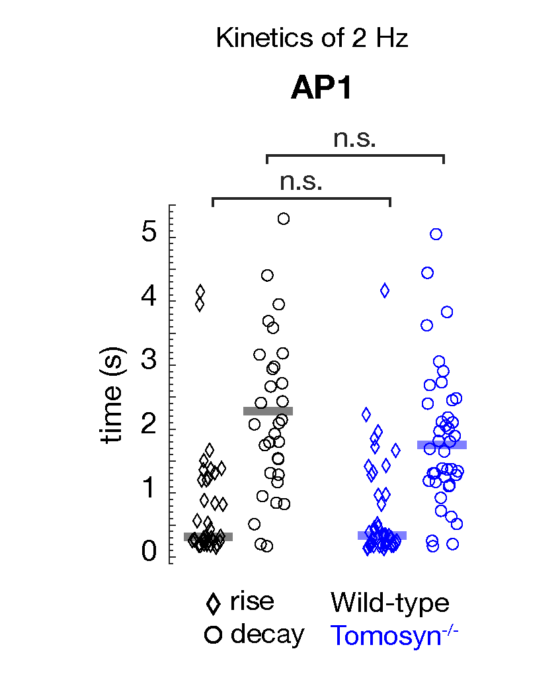
Kinetics of 0.75 Hz response in active synapses only:
Kinetics of 2Hz response in active synapses only:

Slide 35
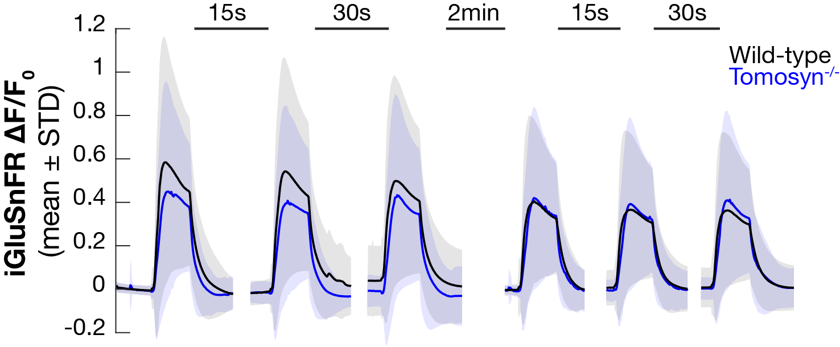
1 mM Glutamate puffs

